Slide 1
Programming II
(C Programming Language)
Pointers in C
(Part II)
Lecture 14, Wednesday March 31, 2021
Dr. Ayman ALJARBOUH

Slide 2
Outline
Array of Pointers
Relationship Between Arrays and Pointers
Pointer to Pointer (Double Pointer) in C
Passing Pointers to Functions in C

Slide 3

Array of Pointers
There may be a situation when we want to maintain an array, which can store pointers to int or char or any other data type available
Following is the syntax of declaration of an array of pointers to an integer:
This declares ptr as an array of MAX integer pointers
Thus, each element in ptr, now holds a pointer to an int value

Slide 4
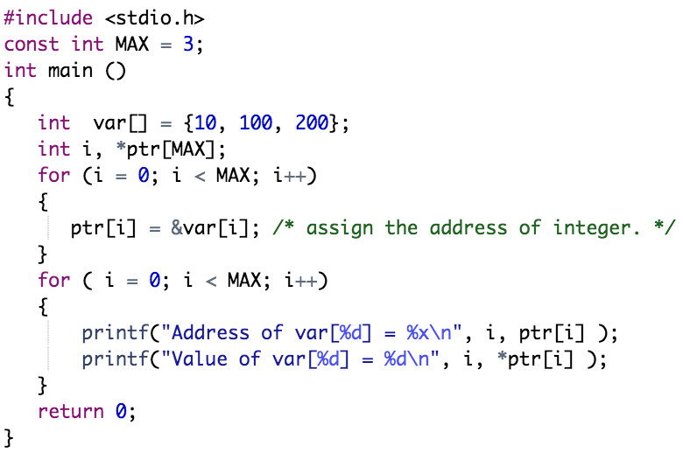
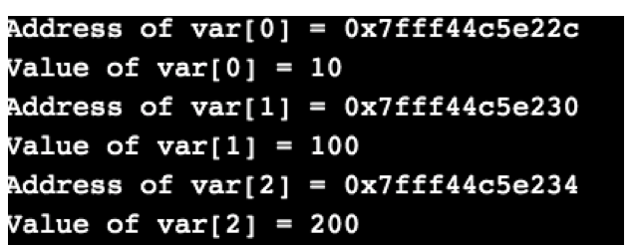
Example:

Slide 5
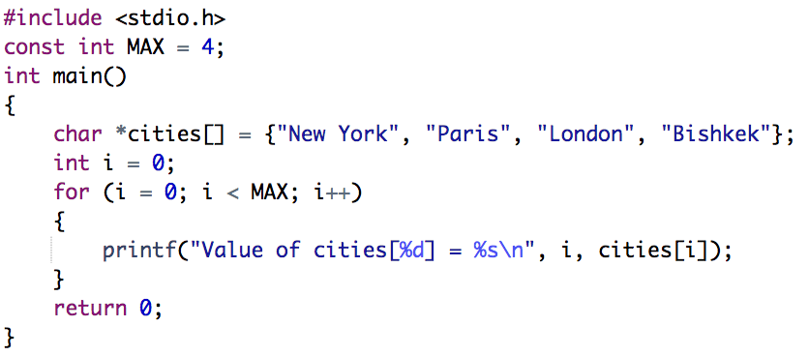
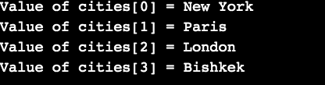
Array of Pointers
You can also use an array of pointers to character to store a list of strings as in the following example
Example:

Slide 6
Outline
Array of Pointers
Relationship Between Arrays and Pointers
Pointer to Pointer (Double Pointer) in C
Passing Pointers to Functions in C

Slide 7
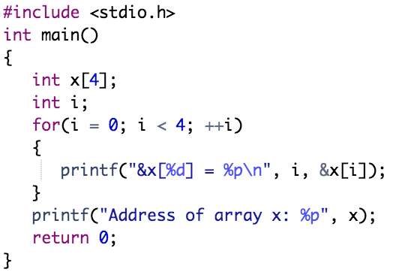
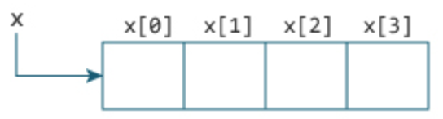
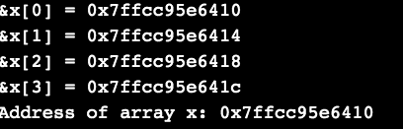
Relationship Between Arrays and Pointers
An array is a block of sequential data. Let's write a program to print addresses of array elements
Notice that, the address of &x[0] and x is the same. It's because the variable name x points to the first element of the array.
Example:
In the example, it is clear that &x[0] is equivalent to x, and x[0] is equivalent to *x. Similarly:
&x[1] is equivalent to x+1 and x[1] is equivalent to *(x+1)
&x[2] is equivalent to x+2 and x[2] is equivalent to *(x+2)
And basically, &x[i] is equivalent to x+i and x[i] is equivalent to *(x+i)

Slide 8
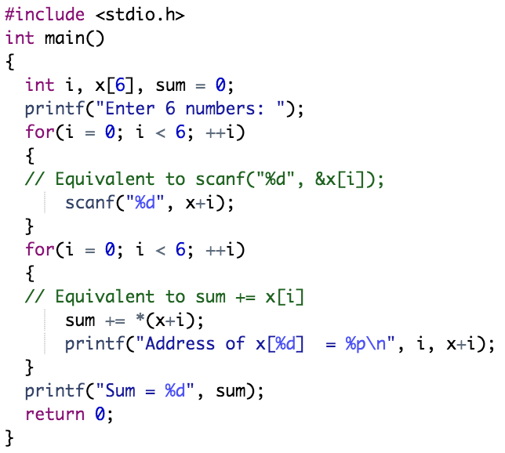
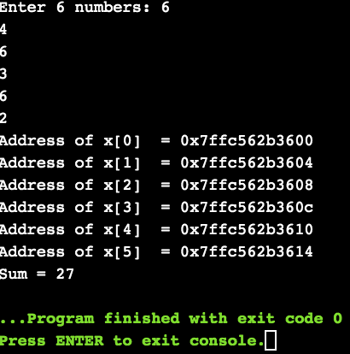
Example:
Here, we have declared an array x of 6 elements. To access elements of the array, we have used pointers

Slide 9
Outline
Array of Pointers
Relationship Between Arrays and Pointers
Pointer to Pointer (Double Pointer) in C
Passing Pointers to Functions in C

Slide 10

Pointer to Pointer (Double Pointer) in C
A pointer to a pointer is a chain of pointers
When we define a pointer to a pointer, the first pointer contains the address of the second pointer, which points to the location that contains the actual value
The syntax for double pointer declaration is:
Following is the declaration of a pointer to a pointer of type int:
When a target value is indirectly pointed to by a pointer to a pointer, accessing that value requires that the asterisk operator be applied twice

Slide 11
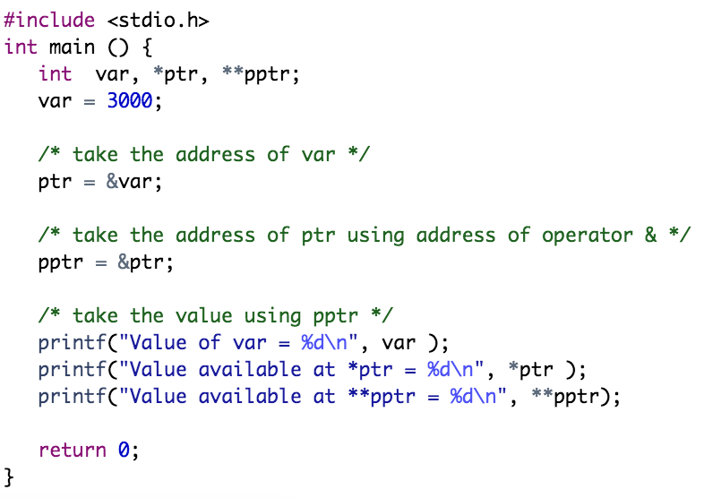
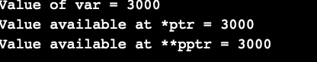
Example:

Slide 12
Outline
Array of Pointers
Relationship Between Arrays and Pointers
Pointer to Pointer (Double Pointer) in C
Passing Pointers to Functions in C

Slide 13
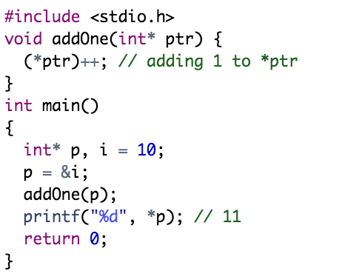
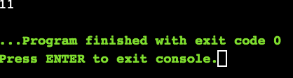
Passing Pointers to Functions in C
C programming language allows you to pass a pointer to a function. To do so, simply declare the function parameter as a pointer type
Example:
Here, the value stored at p is 10 initially. We then passed the pointer p to the addOne() function. The ptr pointer gets this address in the addOne() function

Slide 14
Passing Pointers to Functions in C
C programming language allows you to pass a pointer to a function. To do so, simply declare the function parameter as a pointer type
Example:
Inside the function, we increased the value stored at ptr by 1 using (*ptr)++;. Since ptr and p pointers both have the same address, *p inside main() is also 11

Slide 15
Practical Exercises
Write and Compile the following C programs:
Program 1:

Slide 16
Practical Exercises
Write and Compile the following C programs:
Program 2:

Slide 17
Practical Exercises
Write and Compile the following C programs:
Program 3:

Slide 18
Practical Exercises
Write and Compile the following C programs:
Program 4:

Slide 19
Practical Exercises
Write and Compile the following C programs:
Program 5:

Slide 20
Practical Exercises
Write and Compile the following C programs:
Program 6:

